Slide 1
IP Multicasting

Slide 2
Applications with multiple receivers
Many applications transmit the same data at one time to multiple receivers
Broadcasts of Radio or Video
Videoconferencing
Shared Applications
A network must have mechanisms to support such applications in an efficient manner

Slide 3
Multicasting
Multicast communications refers to one-to-many or many-to-many communications.
Unicast
Broadcast
Multicast
IP Multicasting refers to the implementation of multicast communication in the Internet
Multicast is driven by receivers: Receivers indicate interest in
receiving data

Slide 4
Multicast Groups
The set of receivers for a multicast transmission is called a multicast group
A multicast group is identified by a multicast address
A user that wants to receive multicast transmissions joins the corresponding multicast group, and becomes a member of that group
After a user joins, the network builds the necessary routing paths so that the user receives the data sent to the multicast group

Slide 5
Multicasting over a Packet Network
Without support for multicast at the network layer:
Multiple copies of the same message is transmitted on the same link

Slide 6
Multicasting over a Packet Network
With support for multicast at the network layer:
Requires a set of mechanisms: (1) Packet forwarding can send multiple copies of same packet (2) Multicast routing algorithm which builds a spanning tree (dynamically)

Slide 7
IP Multicasting
There are three essential components of the IP Multicast service:
IP Multicast Addressing
IP Group Management
Multicast Routing

Slide 8
IP Multicast addresses
1. Local scope
The first way—which is useful in purely local environments and labs—is to use the organization local scope from the administratively scoped ranges, 239.192.0.0/14. in that anybody can use them locally within their own network. However, network admins are expected to ensure that they don’t leave the local network.

Slide 9
GLOP addressing (is not an acronym)
2. GLOP addressing is used to give anyone with their own registered public AS number their own globally unique multicast IP address range. – 233.0. 0.0/8 is the reserved GLOP range.
This scheme uses a registered BGP ASN to create a multicast address range.
Since BGP ASNs were originally two bytes long, the GLOP scheme takes the 233.0.0.0/8 range of addresses and encodes that 2-byte ASN into the second and third bytes of the address.

Slide 10
Permanently assigned addresses
3. The third way to get a permanently assigned address in the ranges 224.0.2.0-224.0.255.0 and 224.1.0.0-224.1.255.255 by applying to the IANA. These addresses are in relatively short supply, though. So, unless you have a multicast application that you intend to share with a large number of downstream clients, it’s probably better to use one of the other methods.
Walt Disney’s Multicast addresses are 224.0.19.0-224.0.19.63
Full list of fixed Multicast addresses

Slide 11
Semantics of IP Multicast
Multicast groups are identified by IP addresses in the range 224.0.0.0 - 239.255.255.255 (class D address)
Every host (more precisely: interface) can join and leave a multicast group dynamically
no access control
Every IP datagram sent to a multicast group is transmitted to all members of the group
no security,
Sender does not need to be a member of the group
The IP Multicast service is unreliable

Slide 12
The IP Protocol Stack
IP Multicasting only supports UDP as higher layer
There is no multicast TCP !
User Layer
Socket Layer
Stream Sockets
Datagram Sockets
Multicast Sockets
TCP
UDP
IP
IP Multicast
Network Interface

Slide 13
Multicast Addressing
All Class D addresses are multicast addresses:
Multicast addresses are dynamically assigned.
An IP datagram sent to a multicast address is forwarded to everyone who has joined the multicast group
If an application is terminated, the multicast address is (implicitly) released.

Slide 14
Types of Multicast addresses
The range of addresses between 224.0.0.0 and 224.0.0.255, inclusive, is reserved for the use of routing protocols and other low-level topology discovery or maintenance protocols
Multicast routers should not forward any multicast datagram with destination addresses in this range.
Examples of special and reserved Class D addresses, e.g,

Slide 15
Multicast MAC address
In Ethernet a multicast address is identified by setting the lowest bit of the “most left byte”
The multicast MAC address is a special value that begins with 01-00-5E in hexadecimal. The remaining portion of the multicast MAC address is created by converting the lower 23 bits of the IP multicast group address into 6 hexadecimal characters.

Slide 16
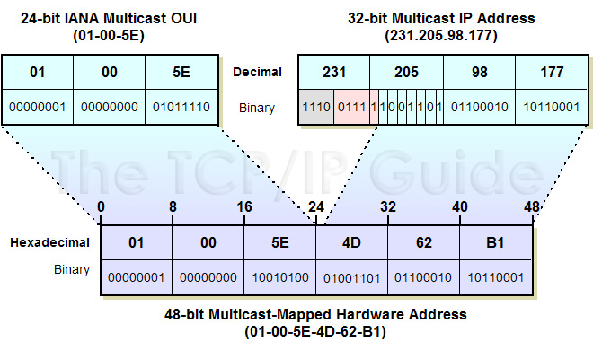
An example of how a multicast address is created

Slide 17
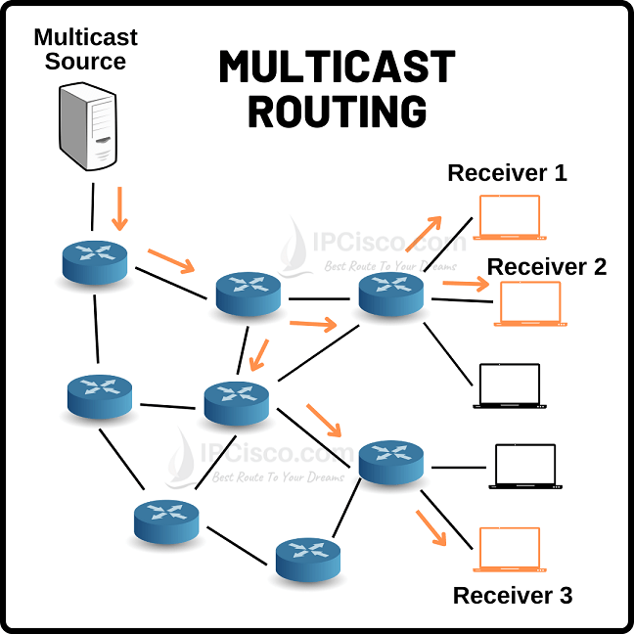

Protocol for edge routers to manage receivers
Protocol for routers to manage if they are to receive traffic

Slide 18
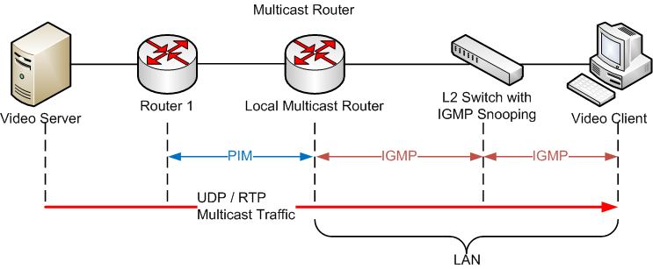
Multicasting protocols

Slide 19
Internet Group Management Protocol (IGMP)
The Internet Group Management Protocol (IGMP) is a simple protocol for the support of IP multicast.
IGMP operates on a physical network (e.g., single Ethernet Segment.
IGMP is used by multicast routers to keep track of membership in a multicast group.
It is only used between a local router and its clients
Support for:
Joining a multicast group
Leaving a multicast group
Query membership
Send membership reports
Notes:
A Multicast Group Membership Discovery protocol is used by receiving hosts to advertise their group membership to a local multicast router, enabling them to join and leave multicast groups. The main Multicast Group Membership Discovery protocols are Internet Group Management Protocol (IGMP) for IPv4 and Multicast Listener Discovery (MLD) for IPv6.

Slide 20
IGMP Protocol
A host sends an IGMP report when it joins a multicast group
Leave Group when a host leaves the multicast group
A multicast router regularly multicasts an IGMP query to all hosts
There are two types of Membership Queries:
- used to learn which groups have members on an attached network.
Group-Specific Query - used to learn if a specific group has any members on an attached network
A host responds to an IGMP query with an IGMP report.
Multicast router keeps a table on the multicast groups that have joined hosts. The router only forwards a packet, if there is a host still joined.
Note: Router does not keep track which host is joined.

Slide 21
IGMP Protocol

Slide 22
Multicast Routing Protocols
Goal: Build a spanning tree between all members of a multicast group
Notes:
A Multicast Routing Protocol is used to communicate between multicast routers and enables them to calculate the multicast distribution tree of receiving hosts. Protocol Independent Multicast (PIM) is the most important Multicast Routing Protocol.

Slide 23
Multicast routing as a graph problem
Problem: Embed a tree such that all multicast group members are connected by the tree

Slide 24
Multicast routing as a graph problem
Problem: Embed a tree such that all multicast group members are connected by the tree
Solution 1: Shortest Path Tree or source-based tree Build a tree that minimizes the path cost from the source to each receiver
Good tree if there is a single sender
If there are multiple senders, need one tree per sender
Easy to compute

Slide 25
Multicast routing as a graph problem
Problem: Embed a tree such that all multicast group members are connected by the tree
Solution 2: Minimum-Cost Tree Build a tree that minimizes the total cost of the edges
Good solution if there are multiple senders
Very expensive to compute (not practical for more than 30 nodes)

Slide 26
Multicast routing protocols in the Internet
Protocol Independent Multicast (PIM): is the most widely used
Runs in two modes: PIM Dense Mode (PIM-DM) and PIM Sparse Mode (PIM-SM).
PIM-DM builds source-based trees using flood-and-prune
PIM-SM builds core-based trees as well as source-based trees with explicit joins.
The following is an explanation of the concepts https://www.youtube.com/watch?v=Gjt2L9jAYNA

Slide 27
PIM-Dense mode
PIM-DM uses a push model to flood multicast traffic to every corner of the network. This push model is a brute force method for delivering data to the receivers. This method would be efficient in certain deployments in which there are active receivers on every subnet in the network.
PIM-DM initially floods multicast traffic throughout the network. Routers that have no downstream neighbors prune back the unwanted traffic. This process repeats every 3 minutes.
Routers accumulate state information by receiving data streams through the flood and prune mechanism. These data streams contain the source and group information so that downstream routers can build up their multicast forwarding table tree.

Slide 28
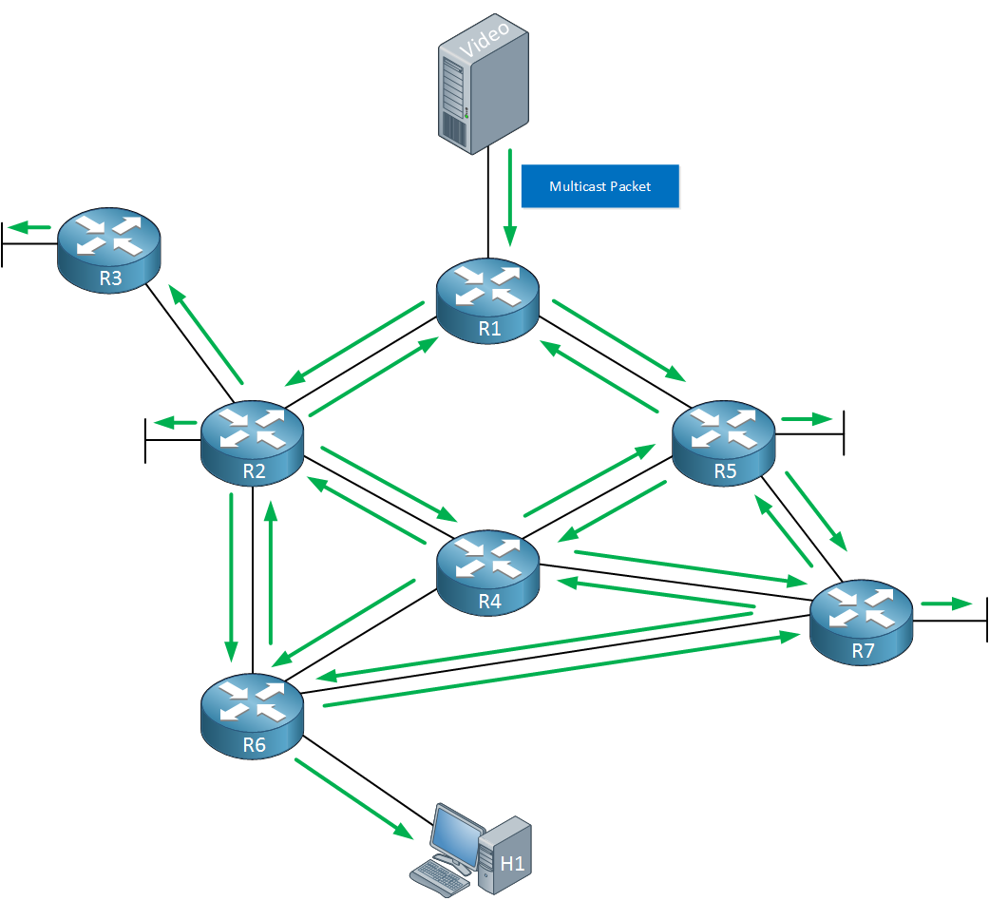
As soon as R1 receives this multicast packet it will create an entry in its multicast routing table where it stores the source address and multicast group address. It will then flood the traffic on all of its interfaces.
Other routers that receive this multicast packet will do the same thing, the multicast packet is flooded on all of their interfaces

Slide 29
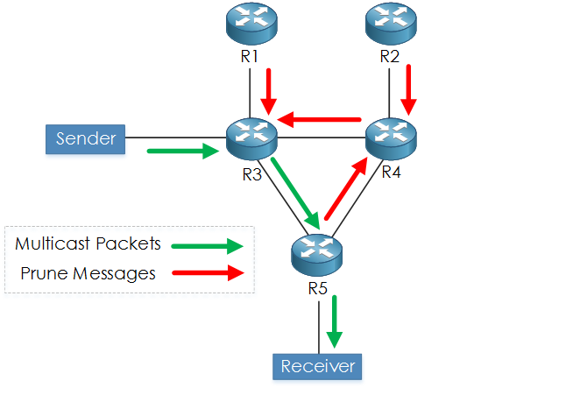
pruning
Each router that has no receivers will send a prune message to its upstream router, requesting it to stop forwarding it
Processes repeats every 3 mins so can eat up bandwidth

Slide 30
Pim sparse mode
IM Sparse Mode (PIM-SM)
PIM-SM uses a pull model to deliver multicast traffic. Only network segments with active receivers that have explicitly requested the data will receive the traffic.
PIM-SM distributes information about active sources by forwarding data packets on the shared tree. Because PIM-SM uses shared trees (at least, initially), it requires the use of a rendezvous point (RP). The RP must be administratively configured in the network.

Slide 31
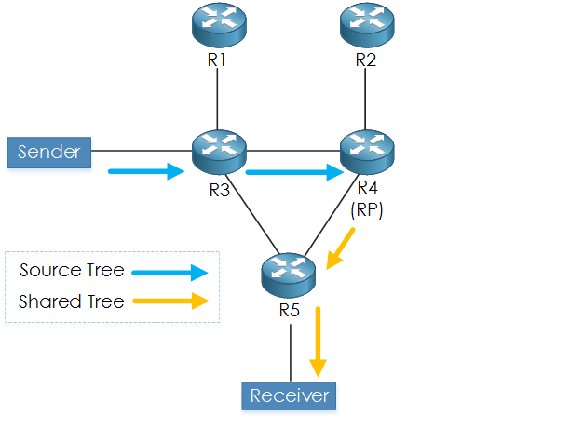
Rendevous point
RP is used as there may be more than one stream from more than one sender and hence they share part of the tree
Sparse mode

Slide 32
Sources register with the RP and then data is forwarded down the shared tree to the receivers. The edge routers learn about a particular source when they receive data packets on the shared tree from that source through the RP. The edge router then sends PIM (S, G) join messages towards that source. Each router along the reverse path compares the unicast routing metric of the RP address to the metric of the source address. If the metric for the source address is better, it will forward a PIM (S, G) join message towards the source. If the metric for the RP is the same or better, then the PIM (S, G) join message will be sent in the same direction as the RP. In this case, the shared tree and the source tree would be considered congruent.

Slide 33
Reverse Path Forwarding (RPF)
RPF builds a shortest path tree in a distributed fashion by taking advantage of the unicast routing tables.
Main concept: Given the address of the root of the tree (e.g., the sending host), a router selects as its upstream neighbor in the tree the router which is the next-hop neighbour for forwarding unicast packets to the root.
This concept leads to a reverse shortest path from any router to the sending host. The union of reverse shortest paths builds a reverse shortest path tree.
reverse path forwarding

